Slide 1
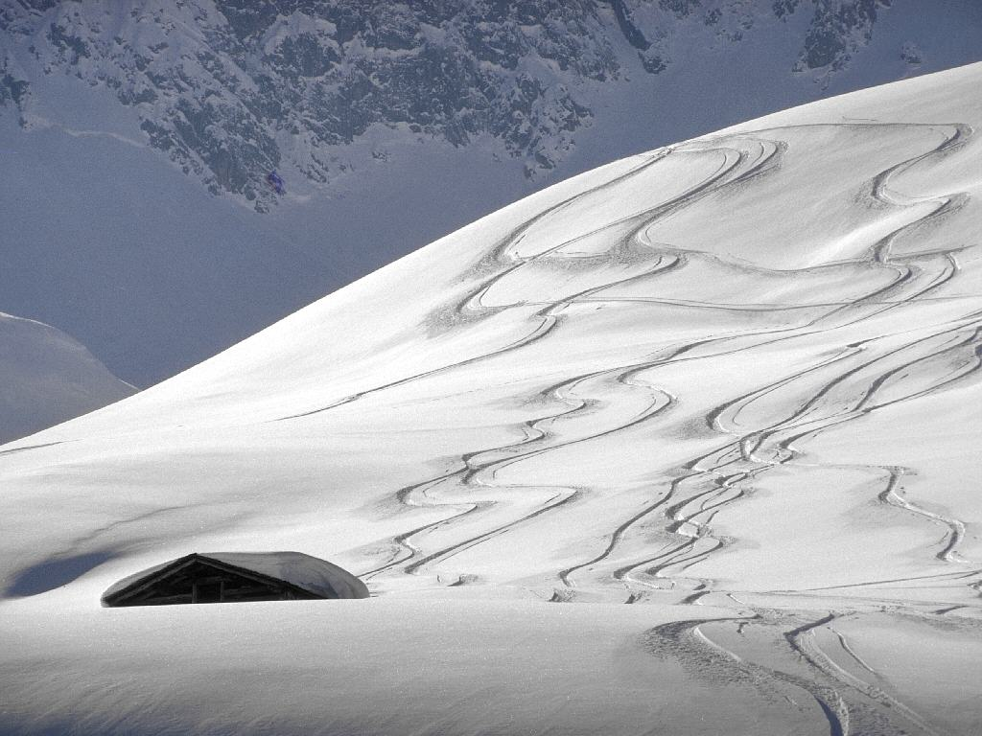
WHAT IS DEMOCRACY ?
WHY DEMOCRACY ?

Slide 2
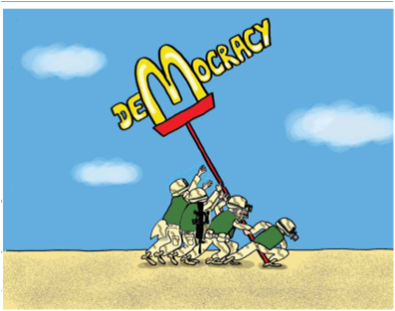
OVERVIEW
We described some governments as democratic and some as non-democratic. We saw how governments in some of those countries changed from one from to the other.
The aim here is to understand clearly the bare minimum feature of a democratic form of government.

Slide 3

Some Important Term
Democratic country: A country where the way a government is formed and the manner in which it functions follow the principles of democracy.
Dictatorship: A system of governance in which all power vest with one person.
Direct Democracy: A system in which all the adult citizens directly participate in making laws and framing the policies.

Slide 4
Non Democratic country: A country where the formation of government and governance do not fallow any principles.
Representative democracy: Also called democracy in this system adult voter elect their representatives who conduct the affairs of the state.
Fair election : A process of election where those currently in power have a fair chance to losing.

Slide 5

WHAT IS DEMOCRACY ?

Slide 6

Democracy have many definition such as :
Democracy is the rule of the people, for the people and by the people.
Democracy is a form of government in which the ruler are elected by the people.
A democracy is one where the citizen have right to elect government though free and fair elections.
They enjoy certain civil liberties guaranteed by constitution and protected by the government.

Slide 7
FEATURES
OF DEMOCRACY

Slide 8
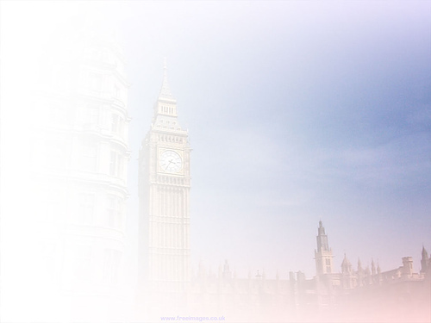

MAJOR DECISION BY
ELECTED LEADERS
In Pakistan, General Pervez Musharraf led a miliary coup in October 1999. He over threw a democratically elected government and declared himself the ‘Chief Executive’ of the country. Later he changed hi designation to President.
In August 2002 he issued a ‘Legal Framework order’ that amended the constitution of Pakistan. According to this order, the president can dismiss the national or provincial assemblies.
The leader elected by the people have no power they cannot take an decision all the powers are in the hands of General Musharraf and army officials. This cannot be called people rule. If people rule should we there then power should we in the hand of the elected people.
This gives us the first feature In a democracy the final decision making power must rest with those elected by the people.

Slide 9
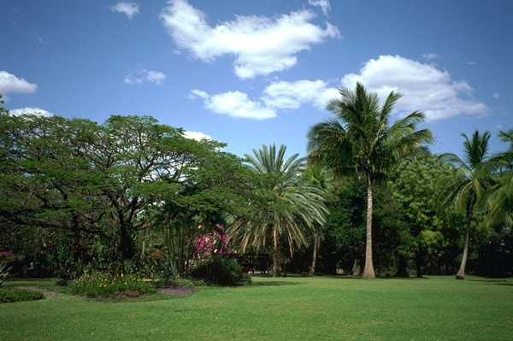
FREE AND FAIR
ELECTION
Mexico hold election after every six year to elect its president. The country has never been under a military or dictator’s rule. But until 2000 every election was won by a party called PRI (Institutional Revolutionary Party). The PRI was known to use many dirty tricks to bin election.
In the Mexican example, people seemed to really have a choice but in practice they had no choice their was no way the ruling party could be defeated, even if people were against it. These are not fair elections.
It should be possible for people to use the choice to remove the existing rulers, if they wish so.
So, a democracy must be based on a free and fair election where those currently in power have a fair chance of losing.

Slide 10

ONE PERSON,ONE VOTE,
ONE VALUE
There are many instance of denial of equal right to vote :
In Saudi Arabia women do not have the right to vote.
Estonia has made its citizenship rules in such a way that people belonging to Russian minority find it difficult to get the right to vote.
In Fiji, the electoral system in such that the vote of an indigenous Fiji has more value than that of an Indian-Fijian.
Democracy is based on a fundamental principle of political equality. That gives us the third feature of democracy: in a democracy, each adult citizen must have one vote and each vote must have one value.

Slide 11

RULE OF LAW AND
RESPECT FOR RIGHT
Zimbabwe shows that popular approval of the rulers is necessary in a democracy, but it is not sufficient . Popular government can be undemocratic . Popular leader can be autocratic. If we wish to accesses the democracy, it is important to look before and after the elections. There should be political opposition, in the period before elections. This requires that the state should respect some basic rights of the citizen. They should be free to think, to have opinions, to express these in public, to form associations, to protest and take other political actions. Everyone should be equal in the eyes of law. These rights must be protected by an independent judiciary.
There are some condition according to which democratic government has to work. It cannot do whatever it likes. It has to respect some basic rules.
These aspects give us the fourth and final feature of democracy: a democratic government rules within limits set by constitutional law and citizens’ rights.

Slide 12


SUMMARY DEFINITION
Through a series of examples we worked out four features of democracy as a form of government. Accordingly, democracy is a form of government in which:
Rulers elected by the people take all the major decisions.
Elections offer a choice and fair opportunity to the people to change the
current ruler.
This choice and opportunity is available to all the people on an equal
basis.
The exercise of this choice leads to a government limited by basic rules
of the constitution and citizens’ rights.

Slide 13
WHY DEMOCRACY ?

Slide 14

ARGUMENTS
AGAINST DEMOCRACY
Leaders keep changing in a democracy. This leads to instability.
Democracy is all about political competition and power play.
There is no scope for morality.
So many people have to be consulted in a democracy that it leads
to delays.
Elected leaders do not know the best interest of the people. It
leads to bad decisions.
Democracy leads to corruption for it is based on electoral
competition.
Ordinary people don’t know what is good for them they should not
decide anything.

Slide 15
ARGUMENTS
FOR DEMOCRACY
A democratic government is a better government because it
is a more accountable form of Government.
Democracy improves the quality of decision making.
Democracy provides a method to deal with differences AND
conflicts.
Democracy enhances the dignity of citizens.
Democracy is better than other forms of government
because it allows us to correct its own mistakes.

Slide 16
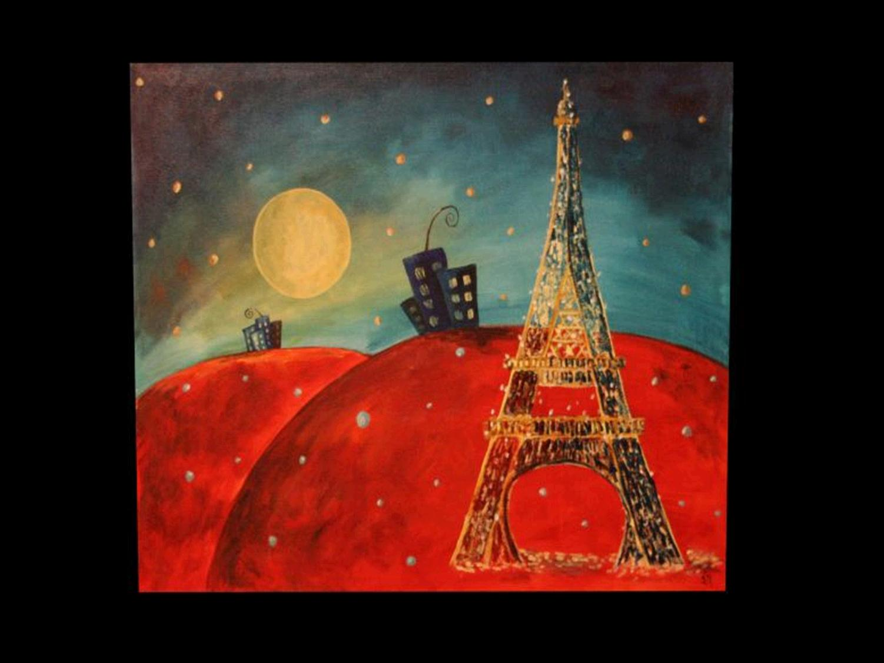
?
?
?
?
?
?
?
?
?
Question year
?
?
?
?
?
?
?
?
?
?

Slide 17
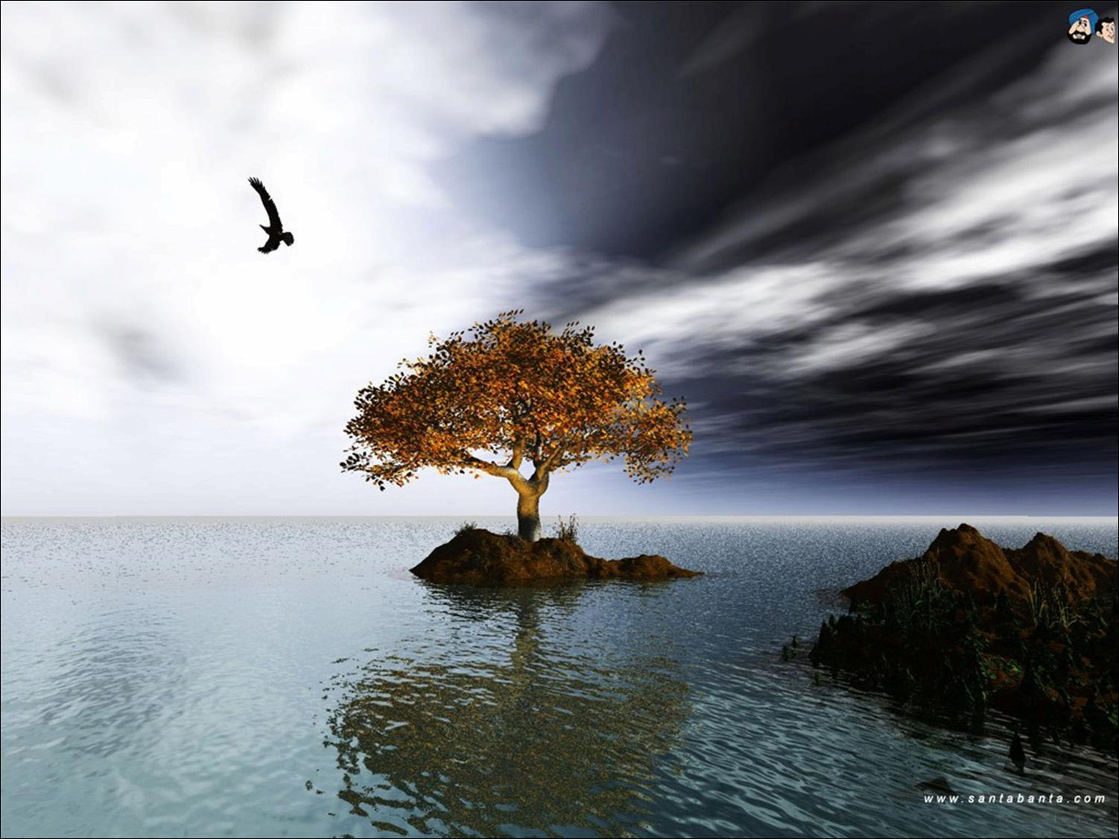
Q.1 What is a representative democracy? What is its importance?
Ans. Representative democracy is one in which people elect their representatives to legislature. These representative, in turn, form the government and govern the country.
In this type of democracy, a government based on majority is allowed to take decision on behalf of all the people.
Representative democracy become necessary because of the following reason :
1. Modern democracies involve such a large number of people that it is physically impossible for them to sit together and take collective decision.
2. Even if they could, the citizen dose not have the time, the desire or the skills to take part in all the decisions.

Slide 18
Q.2 “A democracy must be based in free and fair election.” Elaborate.
Ans. The essence of democracy is that the rulers must be true representative of the people. The representative are chosen through election. Now, an election could have some meaning and significance only if it has been held in a free and fair manner.
A free election is one in which every person has an equal right to vote and is able to vote without fear and threat each one exercise his choice in a judicious manners.
A fair election is one in which those persons who are currently in power have a fair chance of losing. If the election process is rigged and manipulated in such a manner that the result is a foregone conclusion, it dose not constitute a fair election .
“China and Mexico, among many other countries are illustrative examples where the ruling party has never lost any election.”
These type of elections which are not free and fair are against the sprit of democracy.

Slide 19
Q.3 How the universal Adult Franchise was not accepted all over the world?
Ans .There are many instances of denial of equal right to vote:-
(1)In Saudi Arabia women do not have the right to vote.
(2)Estonia has made its citizenship rules in such a way that people belonging to Russian minority find it difficult to get the right to vote.
(3)In Fiji, the electoral system is such that the vote of an indigenous Fiji has more value than that of an India – Fijian.

Slide 20
Q.4 Why is Zimbabwe not considered a democratic country?
Ans. Zimbabwe not considered
a democratic country because
In Zimbabwe, Elections are always won by ZANU – PF, which uses unfair means to remain in power.
(2) Criticism of government’s actions is not allowed.
(3) The citizens have not right to freedom of speech and expression.

Slide 21

Q.5 Distinguish between a nominal democracy and an ideal democracy.
Ans.
Nominal democracy | Ideal democracy
A nominal democracy, as we normally use the term, refer to the system of governance which is run by the people’s elected representatives. | An ideal democracy is a system in which every citizen must be able to play equal role in the decision making. For this one does not need equal right to vote. Every citizen need to have equal information, basic education and a lot of commitment.

Slide 22
Q.6 What is the role of citizens in a democracy?
Ans. No democracy can function in the absence of socially responsible and informed citizens.
Citizens maintain social harmony by mutually respecting and tolerating difference and views of all others who disagree with them.
As citizen have a right to express their dissent, they act as a director of the government when they express their grievance through channels provided by the democratic system.
Citizens play a decisive role in the establishment of a welfare government by participating and seeking to influence the public opinion
When the citizens exercise their right to vote, the provide direction to the whole democratic process.

Slide 23
Q.7 Why democracy called a government by discussion and persuasion.
Ans. It is government by discussion because of the following reasons:
Policies matter are decided after through discussion; in the absence of consensus, the majority view prevails.
Majority view is respected and given due consideration during the decision.
Minority view is heard without being put down by force.
It is government by persuasion because of the following reason:
The opposition is encouraged to participate in debates about government policies and programmes.
During the decision, opponents are persuaded to accept the government viewpoint.
At times, the government itself may see merit in what the opposition has to say and accept it.

Slide 24
Q.8 Who was general Musharraf? What did he done?
Ans. (a). General Musharraf was the president of Pakistan.
(b). In October 1999, he engineered a military coup which overthrew the democratically elected government and establish a military dictator ship in Pakistan.

Slide 25
Q.9 State the four basic feature of a democracy?
Ans. Basics feature of democracy are:
In a democracy, the ruler elected by the people take all the major decisions.
Elections offer the people a choice and a fair opportunity to change their rulers.
The right to vote is available to all irrespective of caste, creed, sex or race.
The government rules within limits set by constitutional law and citizen rights.

Slide 26
Q.10 Mention four demerits of democracy.
Ans. Demerits of democracy are:
Leaders keep changing in a democracy. This led to instability.
Democracy is all about political competition and power play. There is no scope for morality.
So many people have to be consulted that it led to delays.
It leads to corruption as it is based on electoral competition.

Slide 27
Q.11 Why is democracy considered the best form of government?
Ans.
a) Democracy is the best form of government as the ruler are accountable to the people and have to fulfil their needs.
Democracy is based on consultation and discussion. This reduces the chance of hasty and irresponsible decision from being taking and improve the quality of decision-making.
It provides a method to deal with differences and conflicts especially in a diverse country like India. Infact democracy helps to keep our country together.
Democracy enhances the dignity of citizens as it is based on the principle of political equality.

Slide 28
Q.12 How can the principles of democracy be applied to all spheres of life
Ans.
The word democracy is the basic sense is a method of taking decisions. A democratic decision involves consultation with and the consent of all those who are affected by the decision.
Every individual irrespective of his wealth, status and power has the same right in decision making. This can equally apply to a government, a family or any other organization. Thus principle of democracy can be applied to any sphere of life.

Slide 29

THANKYOU
By SK Shandilya

